Slide 1
Software Testing and Quality Assurance
Haiming Liu
liuhaiming@bjtu.edu.cn
School of Software Engineering
Beijing Jiaotong University

Slide 2
16 Weeks Plan
Week 1: The basic concepts and theories of testing
Week 2-3: Principles of Testing
Week 4: Test Cases
Week 5-6: Black Box Testing
Week 7-9: White Box Testing
Week 10: Integration Testing and System Testing
Week 11: Usability Testing and Accessibility Testing
Week 12: Security Testing
Week 13: Mutation Testing
Week 14: Software Quality
Week 15: Review I
Week 16: Review II

Slide 3
Cost of Late Testing
60
Assume $1000 unit cost, per fault, 100 faults
$250K
50
40
$360K
30
Fault origin (%)
Fault detection (%)
Unit cost (X)
20
$20K
$100K
$13K
10
$6K
0
Requirements
Design
Prog / Unit Test
Integration Test
System Test
Post-Deployment
Notes:
假设有100个故障，发现和修复每一个的成本是1000

Slide 4

Relative cost of bugs “bugs found later cost more to fix”
Cost to fix a bug increases exponentially (10^{x})
i.e., it increases tenfold as time increases
E.g., a bug found during specification costs $1 to fix.
… if found in design cost is $10
… if found in code cost is $100
… if found in released software cost is $1000
Notes:
修复错误的成本呈指数增长

Slide 5
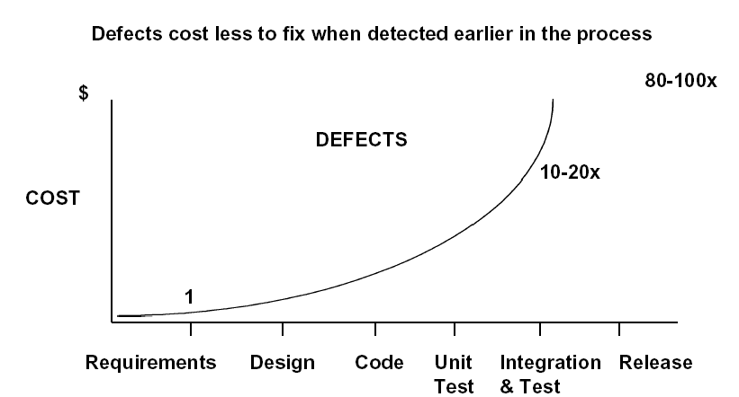

Slide 6
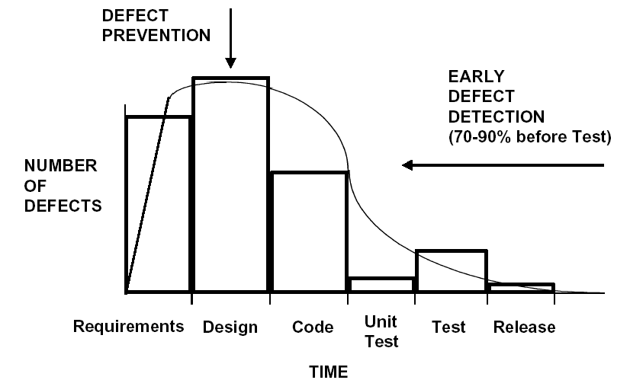

Slide 7
The Cost of bugs

Slide 8
Cost of Not Testing
Testing is the most time consuming and expensive part of software development
Not testing is even more expensive
If we have too little testing effort early, the cost of testing increases
Planning for testing after development is prohibitively expensive
Poor Program Managers might say: “Testing is too expensive.”

Slide 9
Bug Free Software？
Software is in the news for the wrong reason
Security breach, Mars Lander lost, hackers getting credit card information, etc.
A bug free world?
Just imagine a world where every mobile app on your phone works perfectly. Your apps never crash and they always do exactly what you expect them to. Every website that you’re browsing adapts perfectly to your screen and everything just works. Companies don’t lose millions of dollars and customers never complain about software bugs, because they just don’t exist. That’s a great dream, but how real is it?

Slide 10

Why can’t software engineers develop software that just works?
Building reliable software is not a trivial process. Software has a big level of complexity that is impacted by multiple inside and outside factors:
1. Architecture Complexity
2. Software Dependencies
3. Development cost
4. Compatibility issues
5. Code is not the only source of bugs
6. Team-work
Notes:
为什么要找出bug如此困难？
构建可靠的软件并非易事。软件具有高度的复杂性，并受多种内部和外部因素的影响：
架构复杂度
软件依赖关系
开发费用
相容性问题
代码不是bug的唯一来源
团队合作

Slide 11
Discussion …
Do you think bug free software is unattainable?
Are their technical barriers that make this impossible?
Is it just a question of time before we can do this?
Are we missing technology or processes?

Slide 12
Goal of a software tester
… to find bugs
… as early in the software development processes as possible
… and make sure they get fixed.
Advice: Be careful not to get caught in the dangerous spiral of unattainable perfection.
Notes:
寻找错误
尽早在软件开发过程中
并确保将其改了，修复了。
建议：千万注意不要陷入无法达到的完美境界的危险漩涡中

Slide 13
Summary: Why Do We Test Software ?
A tester’s goal is to eliminate faults as early as possible
Improve quality
Reduce cost
Preserve customer satisfaction
Notes:
提高质量
降低成本
保持客户满意度

Slide 14
What to look for when interviewing someone for the position of software tester
Are they explorers?
Are they troubleshooters?
Are they relentless?
Are they creative?
Are they perfectionists (within reason)?
Do they exercise good judgment?
Are they tactful and diplomatic?
Are they persuasive?
Notes:
探索者
故障排除员
不抛弃，不放弃
创造性
完美主义者
能行使良好的判断力
注重机智和外交
善于说服

Slide 15
Software Testing Is Fun!
A fundamental trait of software testers is that they simply like to break things.
They live to find those elusive system crashes. They take great satisfaction in laying to waste the most complex programs.
They’re often seen jumping up and down in glee, giving each other high-fives, and doing a little dance when they bring a system to its knees.
It’s the simple joys of life that matter the most.

Slide 16
You now know …
… what is a bug
… the relationship between specification and bugs
… the cost of a bug relative to when it is found
… the unattainable goal of perfect software
… the goal of the software tester
… valuable attributes of a software tester

Slide 17
The Software Development Process
Principle of Testing

Slide 18
To be an effective software tester, it’s important to have at least a high-level understanding of the overall process used to develop software
The creation of a new software product may involve dozens, hundreds, even thousands of team members all playing different roles and working together under tight schedules
The specifics of what these people do, how they interact, and how they make decisions are all part of the software development process

Slide 19
With this knowledge you’ll have a better understanding of how best to apply the software testing skills you learn in the later class
• What major components go into a software product
• What different people and skills contribute to a software product
• How software progresses from an idea to a final product
Notes:
软件产品包含哪些主要组件
不同的人和技能对软件产品有何贡献
软件如何从一个想法发展到最终产品

Slide 20
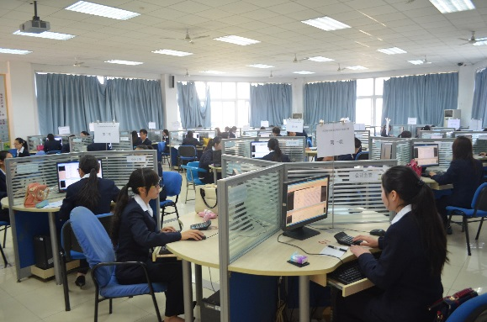
Product Components
Software effort
Specification
Product reviews
Design
Scheduling
Feedback
Competitive information
acquisition
Test planning
Customer surveying
Usability data gathering
Look and feel specification
Software architecture
Programming
…
Notes:
产品说明书
产品审查
设计文档
进度表
以前版本的反馈
竞争对手的信息
测试计划
用户调查
易用性测试
外观说明
软件系统结构
软件代码等等

Slide 21
Product Components
Customer Requirements (Surveys, competitive info, Feedback)
MRD (Task/Feature description, Usability Data)
Specifications
Schedule
Design Docs (Architecture, Feature implementation, Interface agreement)
Test Documents (Plans, test cases, QA Milestone reports)
Online help
Release Notes / Read Me
Release packages
Market Requirement Document，MRD
Notes:
客户需求（调查，竞争信息，反馈）
MRD（任务/功能描述，可用性数据）v市场需求文档，简称为MRD。（英文全称Market Requirement Document，MRD）
产品说明书
软件设计文档（架构，功能实现，接口协议）
测试测试（计划，测试用例，质量保证里程碑报告）
网上帮助
发行说明/自述，用户文档，帮助手册
发部包

Slide 22
Customer requirements
The software development team must determine what the customer wants.
How can you do this?
Guess?
Collect detailed information from surveys?
Get feedback from a previous version of the software?
Read reviews in magazines?
Get information about the competition?
Other ways?
The collected data is used to guide the specification effort.
Notes:
软件开发团队必须确定客户的需求。为了满足客户的需求，产品开发小组必须摸清楚客户所想，不能凭空想象。
收集的数据用于指导规范工作。有些正规的有些不正规的，这些数据被用来研究、题练、分析，最后确定软件产品应该具有哪些功能。

Slide 23
Writing MRD AND SPEC
A project management issue - but a difficult one
For our purposes, verifiability is critical:
The system should be easy to use and user errors should be minimal.
Experienced controllers should be able to use all the system functions after a total of two-hours of training.
After training, the average number of errors made by the experienced controllers will not exceed two per day.
But there are still problems. What are they?
Notes:
一个项目管理问题-但一个棘手的问题
就我们的目的而言，可验证性至关重要：
系统应该易于使用，并且用户错误应该最少。
经验丰富的控制器应该经过总共两个小时的培训后才能使用所有系统功能。经过培训后，有经验的控制员平均每天犯错误的次数不会超过两次。

Slide 24
Specification “If you don't know where you're going any road will take you there”
The specification takes the data from the customer requirements and other sources and defines:
The features of the software (functional requirements).
The constraints on these features (non-functional requirements).
Specifications can be:
formal (e.g., aerospace industry), rigid
informal (e.g., a .com start up), on a cocktail napkin or a whiteboard.
Notes:
该产品说明书从客户需求和其他来源获取数据，并定义：
软件的功能（功能要求）。
这些功能的约束（非功能要求）。
规格可以是：
正规的（例如，航空航天业），死板的
非正式（）在纸上写。

Slide 25
System Functional requirements
Other software requirements
Customer requirements Specification
Unit Test
Design Specification
User Environment
Unit Test
Components
Integration Test
Function Test
System Test
Acceptance Test
Installation Test
Integrated modules
Functioning system
Verified, validated software
Accepted test
System in use
Unit Test

Slide 26
SOME WAYS TO QUANTIFY
Speed:
Processed transactions/second; user-response time; screen refresh time.
Size:
Number of bytes; number of records; number of transactions.
Ease of use:
Training time; number of help frames; define classes of users objectively
Notes:
如何对这些需求进行量化
速度
尺寸
使用方便

Slide 27
SOME WAYS TO QUANTIFY
Reliability:
Mean time to failure; probability of unavailability; rate of failure occurrence; availability.
Robustness:
Time to restart after failure; percentage of events causing failure; probability of data corruption on failure.
Portability:
Percentage of target-dependent statements; number of target systems.
Notes:
可靠性
坚固性
可移植性

Slide 28
Schedules
The goals of scheduling are to know:
What work needs to be completed?
How much work is left to do?
When will the work be finished?
Who will finish each task?
Other measurable queries.
A Gantt chart is a popular type of bar chart that illustrates a project schedule.

Slide 29
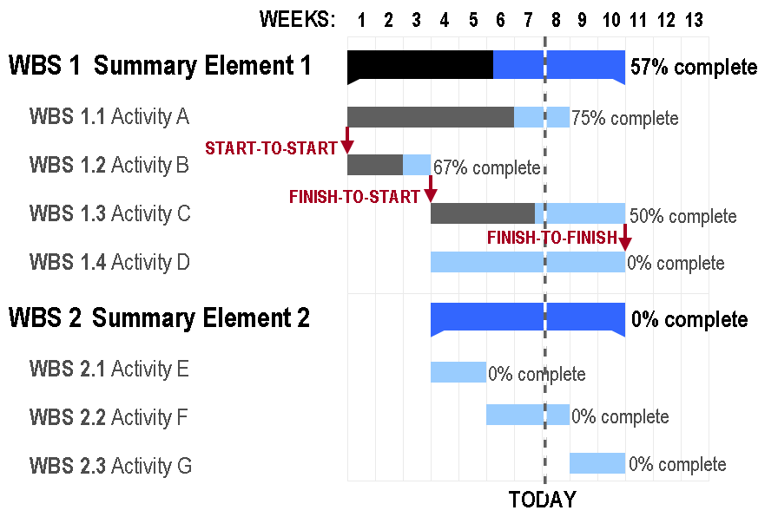
Gantt Chart

Slide 30
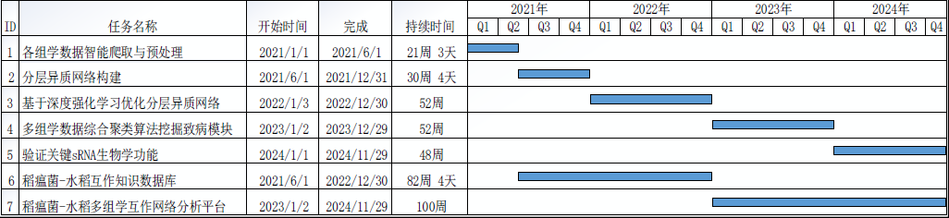
Gantt Chart

Slide 31
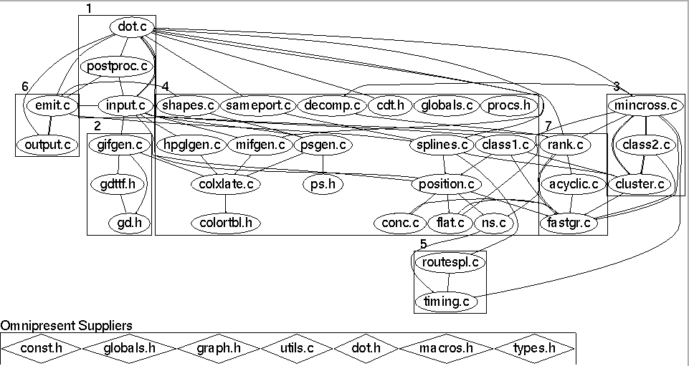
Design
Before coding begins on non-trivial software projects, a set of design documents are created to serve as blueprints.
Software Architecture
Data flow diagram
State transition diagram
Flowchart
Commented code
Notes:
软件设计文档

Slide 32
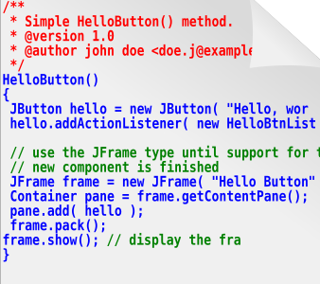
Source code … of course
The ultimate specification of the software!
‘Code is king’ philosophy is still prevalent.
Many programming languages and tools to choose from.

Slide 33
Test documents
Test plan
Quality objectives, resource needs, schedules, assignments, methods, etc.
Test cases
Inputs and expected outputs.
Bug reports
E.g., the Bugzilla web-based bug tracker.
Test tools and automation
Metrics, statistics, and summaries
Number of unresolved bugs, mean time to repair a bug, etc.
Notes:
测试文档
测试计划
质量目标
测试用例
错误报告
测试工具和自动测试，
度量统计和总结

Slide 34
Software Project Staff
Project managers
Write product specification, manage the schedule, critical decision tradeoffs
Software architects, system engineers
Design the software, work closely with programmers
Programmers, developers, coders
Write code, fix bugs
Testers, quality assurance staff
Find bugs, document bugs, track progress of open bugs
Technical writers
Write manuals, on line documentation
Configuration managers, builders
Packaging and code, documents, and specifications
Notes:
项目经理
软件架构师，系统工程师
程序员，开发人员，编码人员
测试人员，质量保证人员
技术作者
配置管理员，构建员

Slide 35
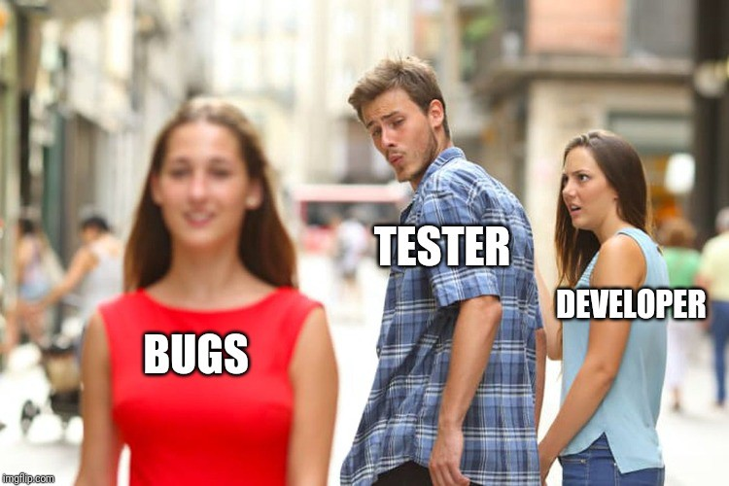
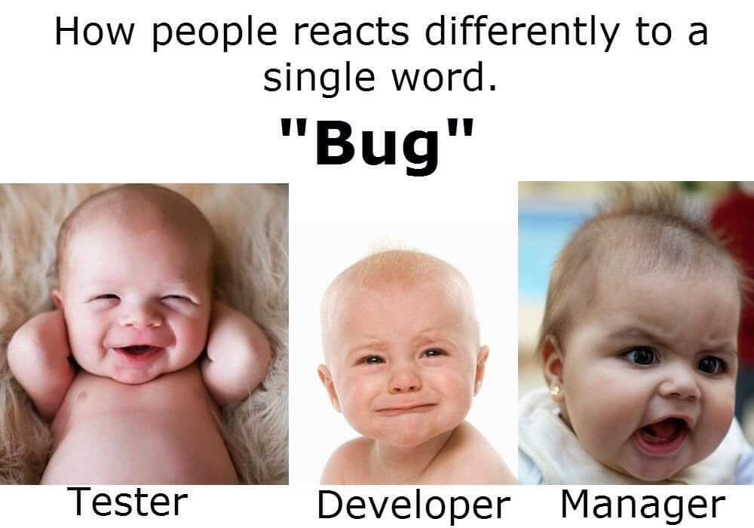
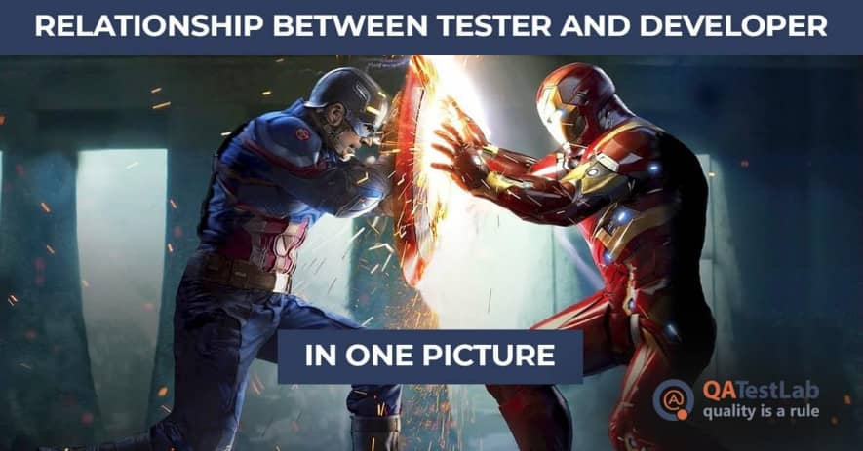
DEBUGGING vs. TESTING
TESTER DEBUGGER
Developer Developer
Test team Analyst
QA team
End user
THERE IS A FUNDAMENTAL CONFLICT BETWEEN THESE ROLES

Slide 36
Software Development Life Cycle
Begins when an application is first conceived.
Ends when it is no longer in use.
Includes:
Initial conception
Requirements/ specification analysis
Functional design
Internal design
Documentation planning
Test planning
Coding
Documenting
Integration
Testing
Maintenance
Updates
Retesting
Phase-out
Many different models are possible for sequencing
these activities!

Slide 37
Activities in SDLC
Project Planning
Analysis
Design
Implement
Test
Roll-out
Initiate project & Organize
UI Design
User Req’ts
Req’ts Analysis
Project Definition & Planning
Technical Design
Detailed Design
Perform Integration Test
Perform System Test
Coding
Convert Site
Quality Requirements
Management Review & Approval
Quality Verification
Test Planning & Preparation
User Procedure & Training
Roll-out Planning & Preparation
Notes:
Software Development Life Cycle

Slide 38
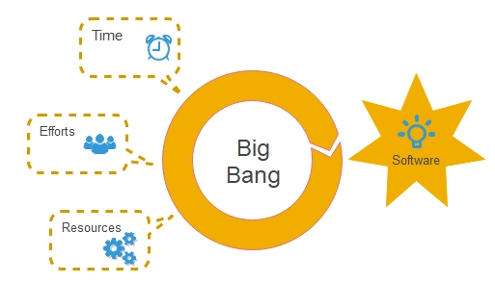
Big-Bang Model
Try to stay away from testing in this model.
In most cases, there is little to no formal testing done under the big-bang model.
If you are called in to test a product under the big-bang model, you have both an easy and a difficult task.

Slide 39
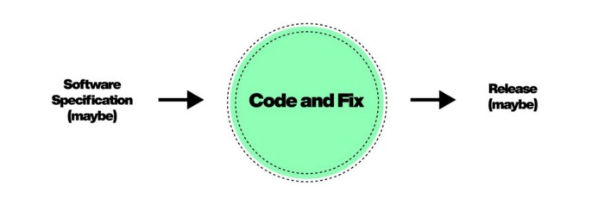
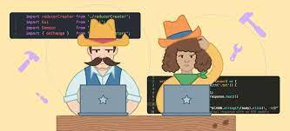
Code-and-Fix Model
“There’s never time to do it right, but there’s always time to do it over.”
A team using this approach usually starts with a rough idea of what they want, does some simple design, and then proceeds into a long repeating cycle of coding, testing, and fixing bugs.
At some point they decide that enough is enough and release the product.

Slide 40
Waterfall Model with Prototyping
Requirements Analysis
System Design
Program Design
Coding Unit Test
Integration Testing
Prototyping
System Testing
User/Customer
Acceptance Testing
Operation maintenance

Slide 41
Rapid Application Development (RAD) - V Model
Operation maintenance
Validate requirements
Requirements Analysis
Acceptance Testing
System Design
System Testing
Verify design
Program Design
Unit Test Integration Testing
Design/Analysis
Verify/testing
Coding

Slide 42
Test-Driven Development
Putting Testing First
Notes:
TDD是测试驱动开发（Test-Driven Development）

Slide 43
The Increased Emphasis on Testing
Philosophy of traditional software development methods
Upfront analysis
Extensive modeling
Reveal problems as early as possible
Notes:
传统软件开发方法的哲学
前期分析
扩展建模
尽早发现问题

Slide 44
The Increased Emphasis on Testing
These are true if requirements are always complete and current
But those annoying customers keep changing their minds!
Humans are naturally good at approximating
But pretty bad at perfecting
These two assumptions have made software engineering frustrating and difficult for decades
Thus, agile methods …

Slide 45
Why Be Agile ?
Agile methods start by recognizing that neither assumption is valid for many current software projects
Software engineers are not good at developing requirements
We do not anticipate many changes
Many of the changes we do anticipate are not needed
Requirements (and other “non-executable artifacts”) tend to go out of date very quickly
We seldom take time to update them
Many current software projects change continuously
Agile methods expect software to start small and evolve over time
Embraces software evolution instead of fighting it
Notes:
敏捷方法不适用于当前的许多软件项目开始
需求很快就会过时
敏捷方法期望软件从小开始，随着时间的推移而发展

Slide 46
A Limited View of Correctness
In traditional methods, we try to define all correct behavior completely, at the beginning
What is correctness?
Does “correctness” mean anything in large engineering products?
People are VERY BAD at completely defining correctness
In agile methods, we redefine correctness to be relative to a specific set of tests
If the software behaves correctly on the tests, it is “correct”
Instead of defining all behaviors, we demonstrate some behaviors
Notes:
在传统方法中，我们试图在开始时完全定义所有正确的行为
在敏捷方法中，我们将正确性重新定义为相对于一组特定的测试

Slide 47
Test Harnesses Verify Correctness
A test harness runs all automated tests efficiently and reports results to the developers
Tests must be automated
Test automation is a prerequisite to test driven development
Every test must include a test oracle that can evaluate whether that test executed correctly
The tests replace the requirements
Tests must be high quality and must run quickly
We run tests every time we make a change to the software
Notes:
测试工具有效地运行所有自动化测试，并向开发人员报告结果
测试必须自动化
每个测试都必须包含一个测试周期，它可以评估该测试是否正确执行

Slide 48
Continuous Integration
Agile methods work best when the current version of the software can be run against all tests at any time
A continuous integration server rebuilds the system, returns, and reverifies tests whenever any update is checked into the repository
Mistakes are caught earlier
Other developers are aware of changes early
The rebuild and reverify must happen as soon as possible
Thus, tests need to execute quickly
A continuous integration server doesn’t just run tests, it decides if a modified system is still correct
Notes:
当软件的当前版本可以在任何时间针对所有测试运行时，敏捷方法工作得最好

Slide 49
Acceptance Tests in Agile Methods
Acceptance Test
(Failing)
User Story
TDD Test 1
Change software & Refactor
Tests archived
Acceptance Test
(Passing)
Continue adding TDD tests until acceptance test passes
TDD Test 2
Change software & Refactor
Refactoring avoids maintenance debt
Introduction to Software Testing, Edition 2 (Ch 4)
© Ammann & Offutt
49

Slide 50
To be continued… See you next week？

